Slide 1
Basic Concepts of ANN

Slide 2
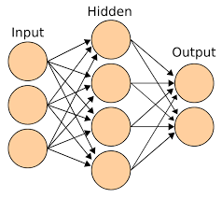
ANNs typically have an input layer, one or more hidden layers, and an output layer. Each neuron in the input layer represents a feature of the input data, while each neuron in the output layer represents a possible classification or prediction.
*2 layer NN(1 hidden layer (4 nodes),
1 output layer (2nodes)
*4+2= 6 nodes/neurons
*so 4+2= 6 Biases
*[3*4]+[4*2]= 20 weights
*Total = wts+biases = 26 Learning Parameters
[3*4]wts
[4*2]wts

Slide 3
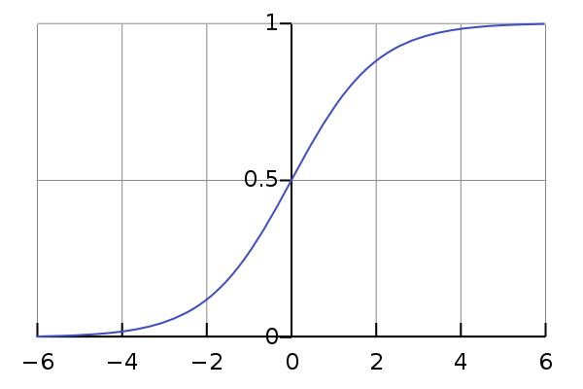
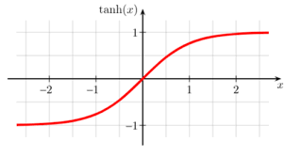
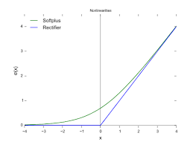
Activation Functions
logistic(sigmoid(0,1))
Tanh(-1,1)
relu(0,∞) softmax/softplus
*Typically a node has an activation func,which is the ideal condition for a feature, depending on its deviation it decides the output(considering wts and bias as in a simple ML model)
*Each i/p node is a feature,NN has huge no of i/p nodes,not possible in ML

Slide 4
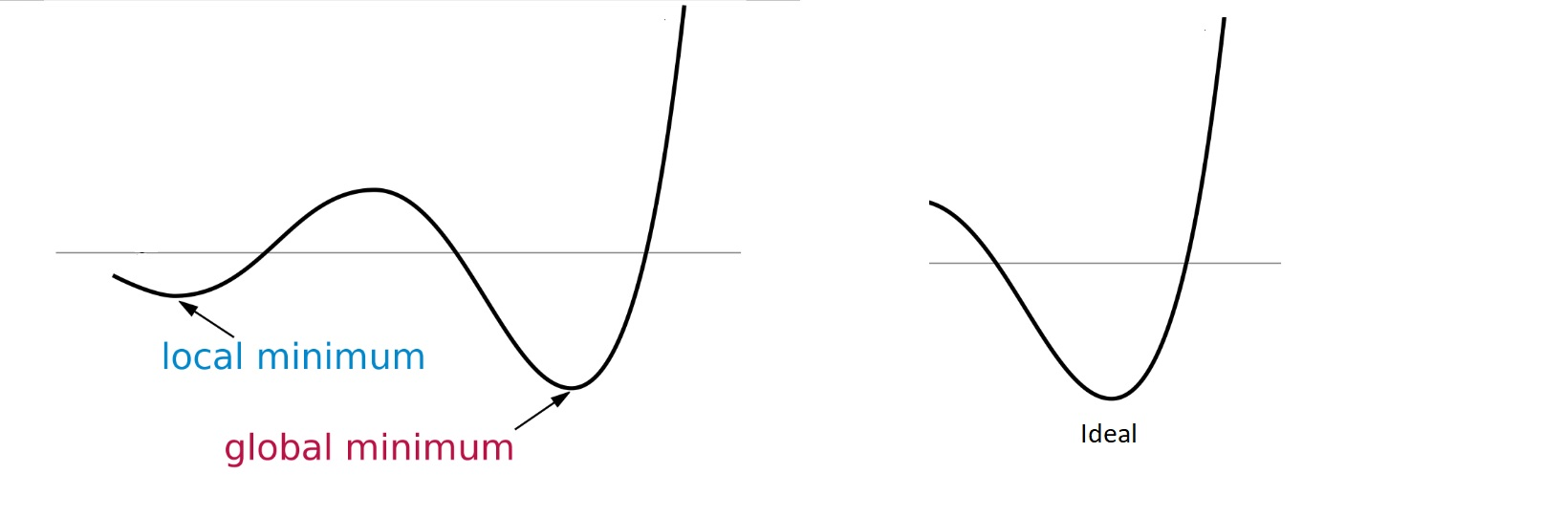
Back Propagation
Gradient Descent optimization:
loss= y-(wx+b), y= actual o/p, x= input, b= bias, w= weight
w^{new}= w^{old} - 𝜆 dL/dw, 𝜆= learning rate, dL/dw= slope for direction calculation
Slope +ve = w^{new} reduces
Slope -ve = w^{new} increases
Vanishing Gradient: gradients of the loss function with
respect to the model's parameters become extremely small.
Exploding Gradient: gradients of the loss function with
respect to the model's parameters become extremely large.

Slide 5
Basic Concepts of CNN

Slide 6
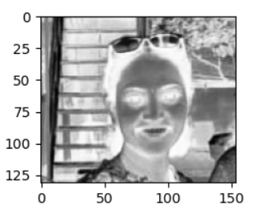
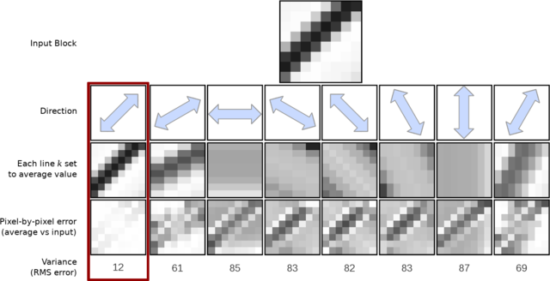
Why CNN?
Humans need only certain features to detect an object, similarly CNN also requires only certain features for detecting, therefore reducing the information in image reduces the processing & storage space, but yet our object detection,classification what ever may be is achieved.

Slide 7
Filter(sharpening) performing convolution

Slide 8
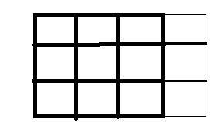
Convolution Layers:
Filter1
2*2*4
s=2
Filter2
2*2*4
s=2
Convo layer2
8*8*8
RGB image
Convo layer1
16*16*4
32*32*3
o/p width= W-F_{w}+2P + 1
S_{w}
W= Image width
F = Filter
P = Padding
S = Stride
(32-2/2)+1=16
16=((32-F_{w}+2P)/2)+1
o/p height= W-F_{h}+2P + 1
S_{h}
F_{w}= 2
Padding size & strides are dependent,if no enough pixels for strides we need to increase padding(eg:3*3 img, 3*3 filter and stride=1)

Slide 9
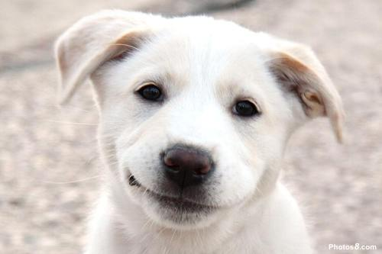
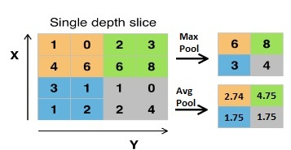
Pooling for dimension reduction

Slide 10
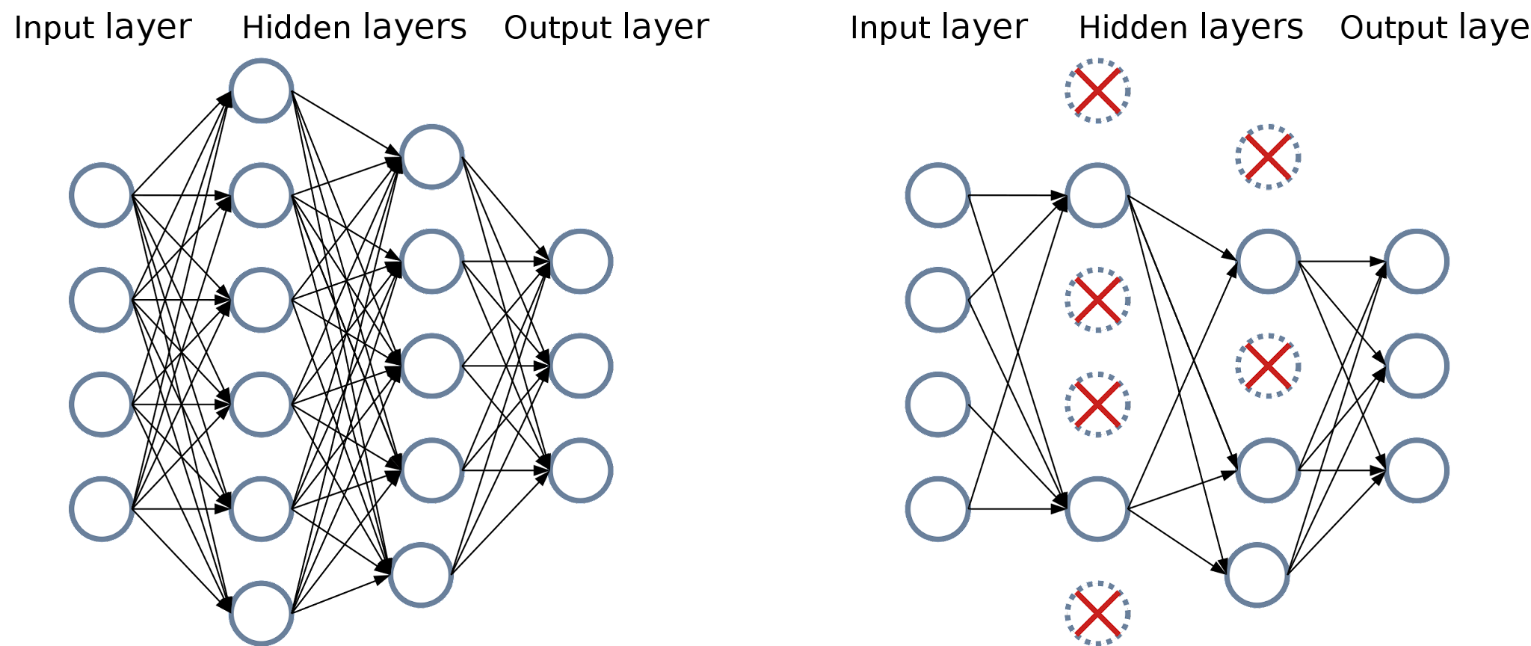
Batch Normalization and Dropouts
Covariate shift
Batch Normalization (BN) is a technique designed to solve the issues caused by internal covariate shift. It involves normalizing the activations of each layer in a neural network based on the statistics (mean and variance). Ie Feature scaling
Dropout

Slide 11
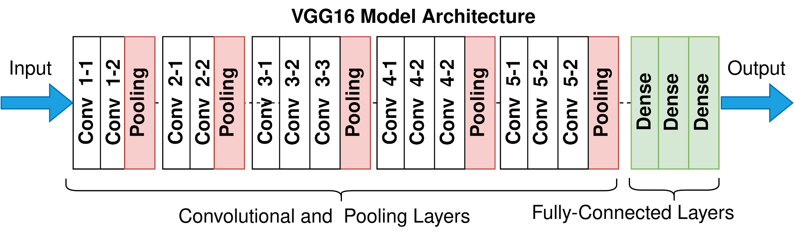
Transfer Learning
Feature learning(filters,CNNs,pool,pad)
Classification part to be designed by engineer
Types of Transfer Learning models
*LeNet
*Alex Net
*Resnet

